Slide 1
This is a hidden slide
Dear honorable teacher please follow the instructions that has given in the slide notes (under the every slide). It would be helpful to take a successful class. Thanks a lot. I wish you good luck.

Slide 2
WELCOME

Slide 3
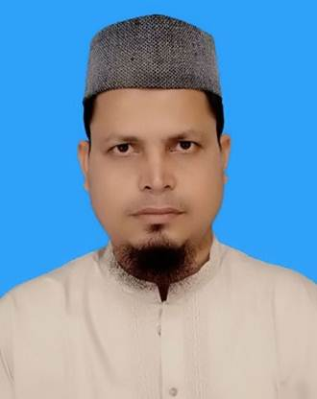
Identity
SK. Md. Harunar Rashid
B.A(Hon’s)M.A.B.Ed.
Senior Assit: Teacher.
Sonatola Model High School, Sonatola, Bogra.
English For Today
Class : Six.

Slide 4
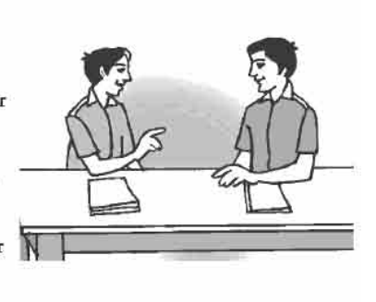
LOOK AT THE PICTURES
This picture is about a conversation.
Do you know what about the pictures ?
Notes:
Showing the picture teacher can ask the question to the whole class. SS will raise their hands. Teacher can ask 5/6 students to narrate the picture.

Slide 5
Lesson declaration
Lesson : 4
Where are you from ?

Slide 6
Learning outcomes
After completing the lesson students will be able to ..
recognize word and stress on words in sentences
talk about people, places and familiar objects in short and simple sentences
ask and answer questions

Slide 7
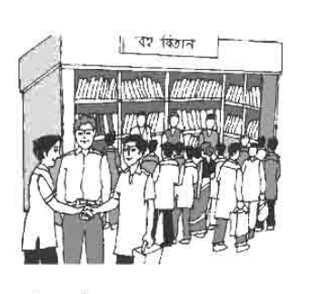
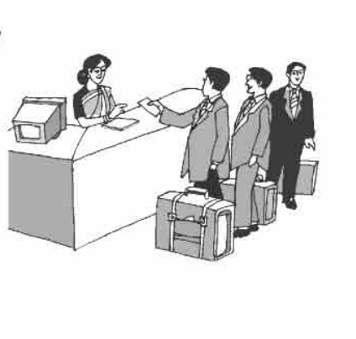
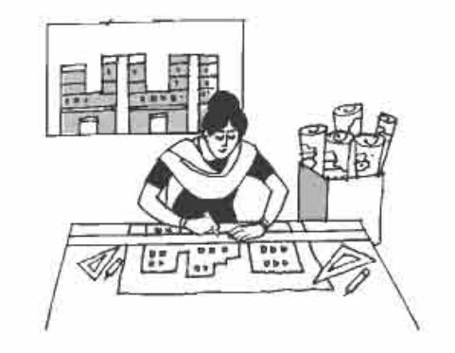
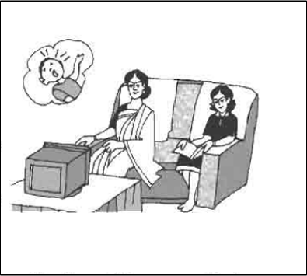
Listen to and then practise the conversations below with your class friends.
Click on pictures captions
Mamun and Akash
Officer & Passenger
Joy and Sajed
Akash and Mamun
Rabeya and Mery
Notes:
Teacher can read the conversations loudly and can discuss the conversations. When students will read and practice the conversations teacher may help them. After reading or discussing teacher can call 2/3 pairs in front of class for practice.

Slide 8
Mamun and Akash
Akash, I would like you to meet …
James. James Collins. Nice to meet you.
I`m from England.
Hello ! My name is Akash. I`m sorry, I could not catch your name.
Nice to meet you, too. Where are you from, James ?
back

Slide 9
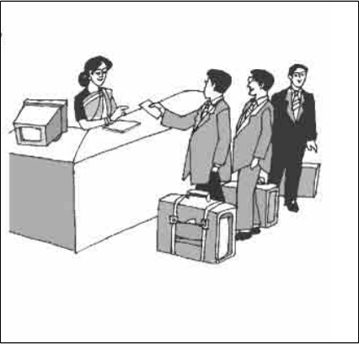
A conversation between immigration officer and passenger
Welcome to Bangladesh, Sir. Have a nice day.
Where do you come from, Mr. Smith ?
Your name , Sir ?
Thank you.
And where are you coming from now ?
Robert Smith.
I am coming from London.
Australia
back

Slide 10
Where do you come from , Sajed ?
I am from Sylhet. My father got transferred here. That`s why I am here in Khulna.
Hello! I am Joy. I am the class captain.
Well, I am sure you will like Khulna and your new school.
I am already your friend !
I know I will. Will you be my friend ?
Hi ! My name is Sajed.
back
Notes:
After showing the conversation teacher can ask his/her students to practice in pair.

Slide 11
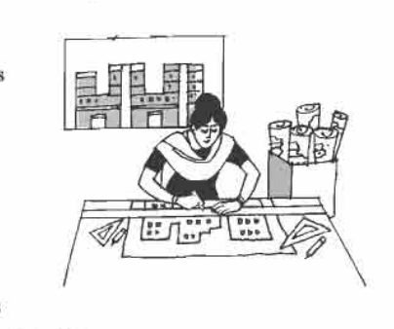
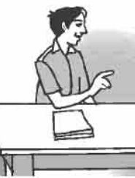
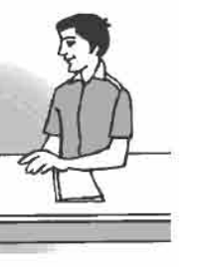
A conversation between Akash and Mamun
Well, at the moment she is designing something different. She is designing a school building at the outskirts of Dhaka.
She is an architect. She mostly designs offices and shopping complexes.
What does your cousin do, Mamun ?
What is she doing at the moment ?
back

Slide 12
A conversation between Mery and her mother Rabeya
I just don`t understand ! That boy is screaming so much ! What`s his mother doing ?
Why, what does she do ?
I don`t think she is at home. May be she is issuing out books to someone at the moment.
She works part-time at the Town Hall Library.
Next

Slide 13
Language Focus.
Notice the difference between “What do you do?” and “What are you doing?” `What do you do?’ means the same as `What’s your profession?’ On the other hand, `What are you doing’ refers to what you are doing at the moment, or to something you are doing around that time.
Use of what do/does --and where do/does --
When subject is 3rd person singular number then we use does. Otherwise we use do.
Example :
What do you do ? / Where do you come from ?
What does he do ? / Where does he come from ?
Notes:
Teacher can discuss about the form of interrogative sentence in present tense and other tenses.

Slide 14
Meet
Key word
I am nice to meet you, Hridoy.
Meaning
(Click here)
When two or more person meet together.
Notes:
First, the word can be shown. The SS can be asked to pronounce the word. If it is needed teacher can help. Then the picture can be shown and asked to guess the meaning. Then the meaning can be shown. Then they can be asked to make a sentence. Teacher can show the sentence for the feedback.

Slide 15
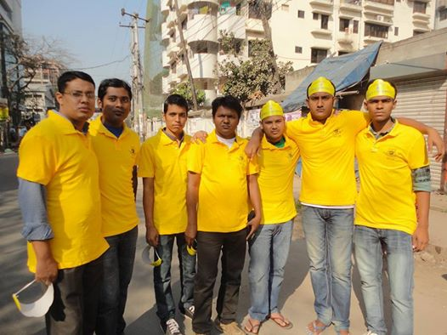
Architect
Key word
They are a set of architect.
Meaning
(Click here)
A person who designs or plans building etc.
Notes:
First, the word can be shown. The SS can be asked to pronounce the word. If it is needed teacher can help. Then the picture can be shown and asked to guess the meaning. Then the meaning can be shown. Then they can be asked to make a sentence. Teacher can show the sentence for the feedback.

Slide 16
Watch
Key word
Our headteacher is watching TV.
Meaning
(Click here)
Observe / look at
Notes:
First, the word can be shown. The SS can be asked to pronounce the word. If it is needed teacher can help. Then the picture can be shown and asked to guess the meaning. Then the meaning can be shown. Then they can be asked to make a sentence. Teacher can show the sentence for the feedback.

Slide 17
Scream
Key word
The baby is crying at the top of its voice.
Meaning
(click here)
Crying at the top of voice.
Notes:
First, the word can be shown. The SS can be asked to pronounce the word. If it is needed teacher can help. Then the picture can be shown and asked to guess the meaning. Then the meaning can be shown. Then they can be asked to make a sentence. Teacher can show the sentence for the feedback.

Slide 18
Look at the following pictures and drag the following words to the appropriate pictures.
Victory day
Student
watch
Grocery shop
Outskirts
All rounder
Cricketer

Slide 19
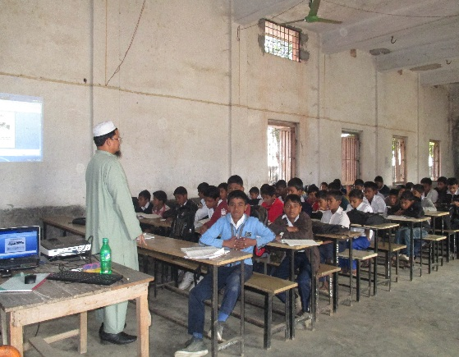
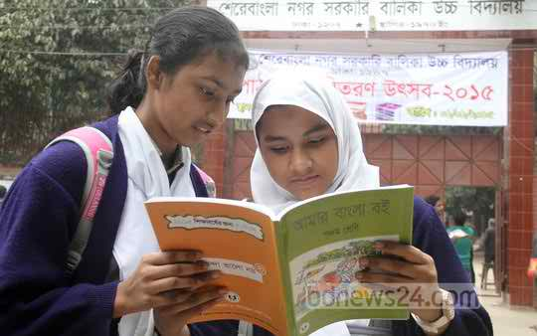
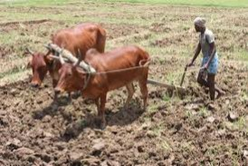
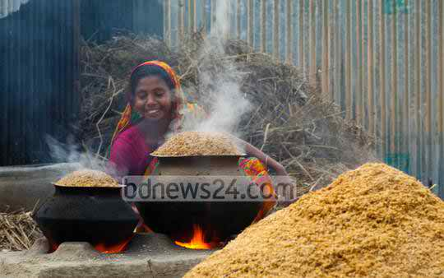
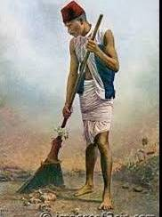
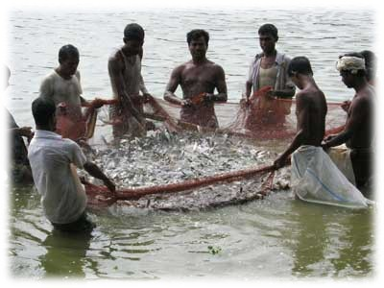
Pair works
Look at the pictures and write about what each person’s profession is, and what he or she is doing at the moment.
One is done for you: Mr. Harun is a teacher, he is taking his class.
Notes:
Teacher can evaluate it by orally or written from the SS.

Slide 20
HOME WORK
Meet with five persons at your home and write down, what are they and what are they doing? at that moment.

Slide 21
THE END

